Slide 1
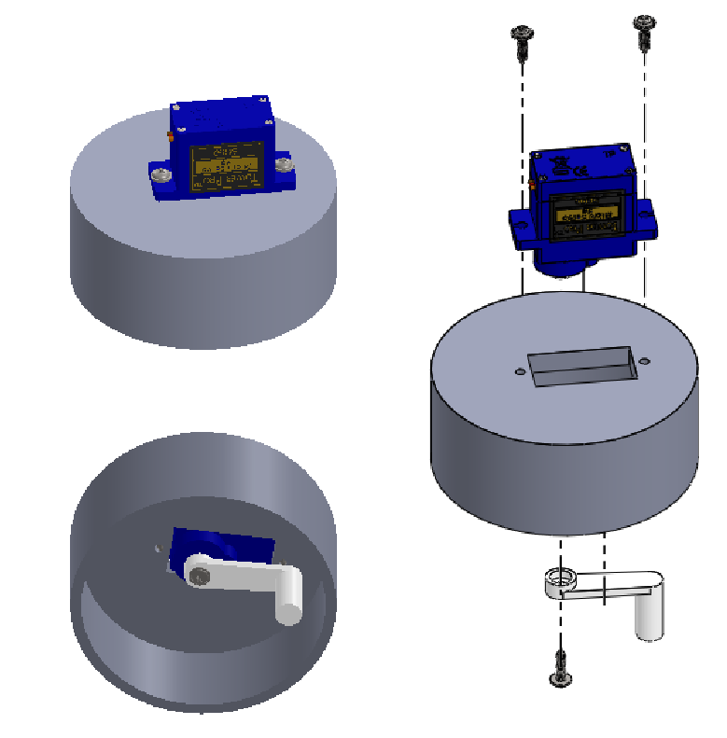
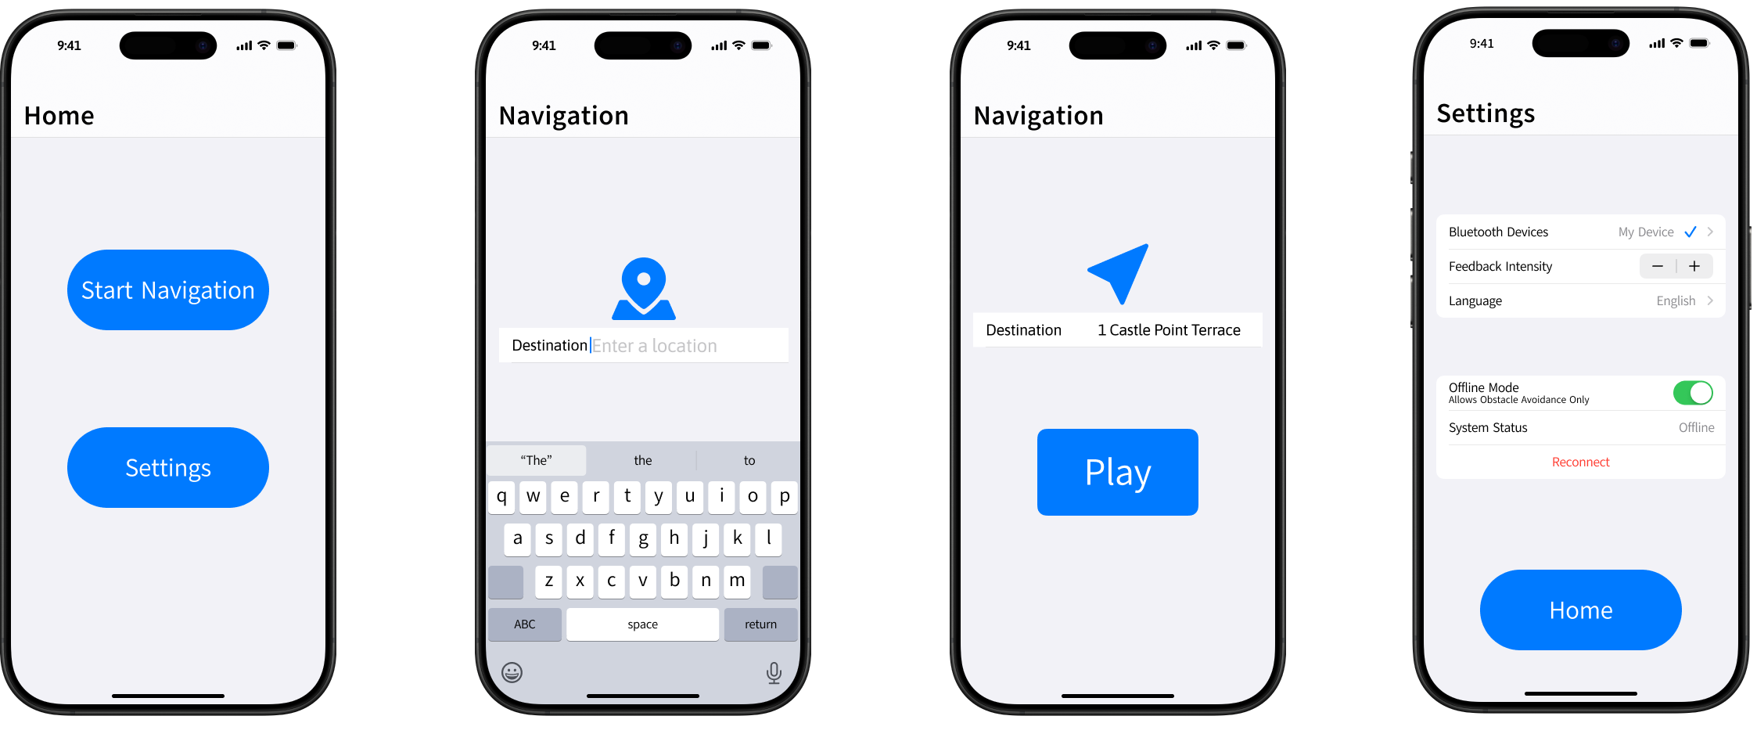
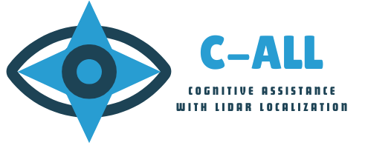
Cognitive Assistance with LiDAR Localization (C-ALL)
Assistive Technology / Smart Mobility Aid
Students: Sohan Chatterjee, Sara Gaber, Neeti Mistry, Ahmad Shah
Advisor: Professor David Darian Muresan, Department of Software Engineering
OBJECTIVE
C-ALL aims to enhance mobility for visually impaired individuals through a smart wearable device. Using LiDAR technology, haptic feedback, and a mobile application, it provides real-time obstacle detection and intuitive navigation assistance. C-ALL also aims to bridge the gap by offering an affordable and user-friendly alternative to traditional mobility aids.
PROBLEM
Visually impaired individual’s face significant challenges navigating public spaces safely. Traditional mobility aids, such as canes and guide dogs, have many limitations.
Limited obstacle detection: Canes often miss obstacles at varying heights or distances, while guide dogs require training and availability.
High costs and accessibility: Guide dogs are expensive to acquire and maintain, while advanced technology solutions are often too costly or impractical for widespread use.
Lack of situational awareness: Current mobility aids don’t provide users with enough detailed or real-time feedback, heavily limiting their independence.
There is a need for a reliable and intuitive solution that improves mobility while keeping safety and independence its main priority.
IMPACT
C-ALL empowers visually impaired individuals with greater independence, safety, and confidence in navigation.
Enhanced Mobility: Provides real-time obstacle detection, reducing reliance on traditional mobility aids.
Increased Accessibility: Offers an affordable and user-friendly alternative to costly mobility solutions.
Improved Safety: Reduces the risk of collisions with precise, real-time feedback from LiDAR and haptic technology.
Personalized Experience: Customizable settings allow users to tailor navigation assistance to best fit their needs.
By bridging the gap between technology accessibility, C-ALL fosters inclusivity and expands choices for the visually impaired community.
CORE FEATURES
LiDAR Obstacle Detection: High-precision LiDAR sensors map the environment in real-time, detecting obstacles at various distances.
Wearable Smart Glove: A lightweight and durable glove with integrated hardware that seamlessly interacts with software for real-time obstacle detection.
Haptic Feedback: Tactile vibrations and motion cues on the user’s hand provide intuitive navigation without overwhelming sensory input.
Mobile App Integration: Developed with Swift, users can input a destination and customize settings for a personalized experience.
Advanced Hardware and Software: Powered by Raspberry Pi, Bluetooth connectivity, microcontrollers, and Swift-based software for seamless communication.
Apple Compatibility: Compatible with iPhone 12 Pro and newer models, leveraging Apple's LiDAR technology and accessibility features.
SOLUTION
C-ALL revolutionizes mobility for the visually impaired by integrating cutting-edge technology into a wearable hardware device and software application. This smart solution integrates LiDAR technology, haptic feedback, and a mobile application to provide real-time obstacle detection and navigation assistance.
LiDAR sensors detect obstacles at varying distances and heights for enhanced environmental awareness.
Haptic feedback provides intuitive navigation through vibrations and movements on the hand to guide the user around obstacles.
The mobile application allows users input a destination and customize feedback settings for a more personalized experience.
Offering a versatile alternative to canes and guide dogs, C-ALL expands mobility aid options for the visually impaired community.

